Slide 1
Welcome
to
Plato Academy Tampa
Music & Art
with Ms. Boylan and Mrs. Kurasz

Slide 2
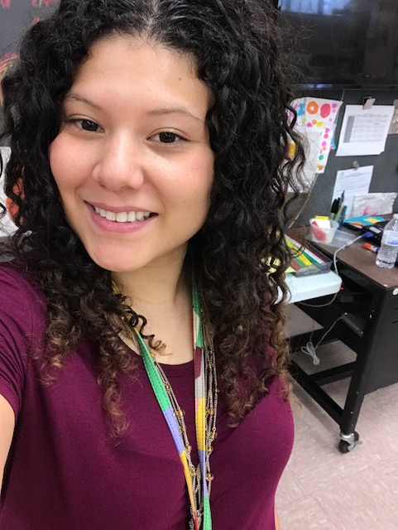
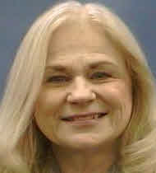
Fun Facts
Ms. Boylan
Mrs. Kurasz
Went to Western Illinois University and the University of Tampa
Was an “au pair” (governess) with a French family
Has 5 kitties: P.K. McWhiskers, Itty Bitty Kitty, Callie Cat, E.T. and Tiger
Teaches private piano lessons
Loves: purple and movies
Went to the University of Central Florida
Worked at Disney World
Has a son named Stanley
Favorite Colors: purple and teal
Love: Hello Kitty

Slide 3
Art and Music Schedule
Art Tuesday | Art Wednesday | Music Thursday | Music Friday
1 1:40-12:25 Luccelli |  | 1 1:40-12:25 Luccelli
12:40-1:25 Deaton | 12:40-1:25 McKnight | 12:40-1:25 Deaton | 12:40-1:25 McKnight
1:40-2:25 Chalela | 1:40-2:25 Sable | 1:40-2:25 Chalela | 1:40-2:25 Sable
2:25-3:10 Rikkola | 2:25-3:10 Falk | 2:25-3:10 Rikkola | 2:25-3:10 Falk

Slide 4
Expectations
Music and Art
Always raise your hand
Remember safety
Treat others, yourself, the instruments and materials with respect
Imagine and Invent your own ideas
Stay in your seat
Talk quietly

Slide 5
Wish List
Music
Art
Complete the “Buy-a-Key” program toward Yamaha CVP 709 Clavinova
($100 per key and an opportunity to sign the permanent keyboard chart!)
Patterned or brightly colored Duct Tape! (no Scotch Brand please)
Black Sharpies
Markers
Colored pencils
White poster board
Pink erasers
Oil pastels
Pencils (any kind)
Tissues
Baby wipes or disinfectant wipes
Empty clear plastic soup containers
Empty large yogurt containers
Empty plastic egg cartons

Slide 6
Volunteer Opportunities
Music
Art
Decorations for concerts/musicals (gather items, decorate gym)
Props (gather or create items)
Set (design and produce backdrops for concerts)
Musicians welcome to visit as a guest performer in class!
Creating student art portfolios (in the art room or at home!)
Square 1 Art Fundraiser product delivery (on the school campus)
Fine Arts Night preparation and station hosting at the event
All volunteers must complete the application process for Hillsborough County Schools.
Contact Mrs. Kurasz or Ms. Boylan if you are interested in volunteering in the music/art room!

Slide 7
Clubs
Music
Art
Music Club will focus on
small group keyboard instruction, beginning techniques,
note reading,
and musical terms.
More information coming soon!
After School Art Club will explore various art mediums, such as, painting, drawing, and collage. Participants will learn about master artists, unconventional artists, and create artworks using learned techniques.
More information coming soon!

Slide 8
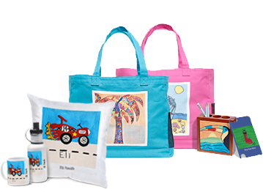
Art Fundraiser
Important Dates:
ORDERS DUE:
October 30th
ORDERS ARRIVE:
November 16th

Slide 9
